Slide 1
World Meteorological Organization Working together in weather, climate and water
WMO
First Technical Workshop on Standards for Hazard Monitoring, Data, Metadata and Analysis to Support Risk Assessment
10-14 June 2013 WMO Headquarters
Geneva, Switzerland Salle B
Linda Anderson-Berry lab@bom.gov.au

Slide 2
World Meteorological Organization Working together in weather, climate and water
WMO
Session 3: National Experiences and Practices for Monitoring, Detection, Development Of Databases, Metadata and Hazard Analysis to Support Risk Assessment
AUSTRALIA
Linda Anderson-Berry lab@bom.gov.au

Slide 3
National Hazard Programme
National Partnership Agreement on Natural Disaster Resilience'
http://www.em.gov.au/npa
http://www.federalfinancialrelations.gov.au/content/npa/environment/natural_disaster_resilience/national_partnership.pdf

Slide 4
National Hazard Program Australian DRR - Priorities
2003-2008 DRR - Mitigation agenda
2009 the Council of Australian Governments (COAG) agreed to adopt a whole-of-nation resilience-based approach to disaster management recognising that a national, coordinated and cooperative effort is needed to enhance Australia’s capacity to withstand and recover from emergencies and disasters- and reduce costs of disasters.
Strategic approach – recognising climate change and the need for long term planning – particularly land use planning

Slide 5
National Hazard Programme Disaster resilience - A SHARED responsibility
Defined in terms of characteristics of a disaster resilient community.
functioning well while under stress;
successful adaptation;
self-reliance; and
social capacity.
Resilience is a responsibility shared between governments, communities, businesses and individuals. (incl insurance; land use planning; Not for Profit etc)

Slide 6
National Hazard Programme National Resilience Agenda Priorities
Development and implementation of a national plan communicating meaningful information about natural hazard risk to the community
Risk assessments are undertaken for priority hazards and widely shared among at-risk communities, stakeholders and decision makers.
Risk assessments consider risks and vulnerabilities and capabilities across the social, economic, built and natural environments.

Slide 7
National Hazards Programme Working definitions
Hazard. A source of potential harm or a situation with a potential to cause loss; a potential or existing condition that may cause harm to people or damage to property or the environment.
Risk. The likelihood of harmful consequences arising from the interaction of hazards, communities and the environment; the chance of something happening that will have an impact upon objectives. It is measured in terms of consequences and likelihood; a measure of harm, taking into account the consequences of an event and its likelihood.

Slide 8
National Whole of Government infrastructure framework for driving resilience agenda
COAG
Council of Australian Governments (COAG). COAG is the peak intergovernmental forum in Australia. Its members are the Prime Minister, State & Territory Premiers and Chief Ministers and the President of the Australian Local Government.
SCPEM
Standing Council on Police and Emergency Management (SCPEM) which is a standing committee of COAG. The purpose of the council is to promote a co-ordinated national response to law enforcement and emergency management issues and looks to develop a shared framework for co-operation and a basis of strategic direction for the policing and emergency services of Australian and New Zealand.
ANZEMC
a senior officials committee – the Australia-New Zealand Emergency Management Committee (ANZEMC) that works to strengthen the nation's disaster resilience by providing strategic leadership on emergency management policy and supporting related capability and capacity development activities.
National Sub-committees
four sub-committees of the ANZEMC: the Community Engagement Sub-committee (CESC), the Capability Development Sub-committee (CDSC), the Risk Assessment, Measurement, Mitigation Sub-committee (RAMMS) and the Recovery Sub-committee. Theses sub-committees have senior representative from a broad range of Federal and State& Territory emergency management organisations.

Slide 9
Risk Assessment, Measurement, Mitigation Sub-committee - RAMMS
National risk assessments
NERAG- National Emergency Risk Assessment Guidelines – a methodology
prepared to improve the consistency and rigour of emergency risk assessments, increase the quality and comparability of information on risk and improve the national evidence-base on emergency risks in Australia.
to provide a contextualised emergency risk assessment methodology consistent with the Australian/New Zealand Standard AS/NZS 4360:2004 Risk Management and the International Standard ISO 31000:2009 Risk management – Principles and guidelines.
Notes:
The NERAG provide a methodology to assess risks from emergency events and are principally concerned with risk assessment. They do not focus on risk management or mitigation, although outputs from applying the methodology support and benefit these. The guidelines are not intended to address the entire risk management framework or the risk management process as outlined in ISO 31000:2009. However, because they focus on the assessment of risks from emergency events, they ultimately direct the management of emergency risks in line with both the Australian and international standards for risk management

Slide 10
NERAG
The guidelines aim to provide a risk assessment methodology that:
enables focus on risks in small (e.g. municipal) or large (e.g. regional and/or state and/or national) areas
is useable for both risk ‘from’ and risk ‘to’ (e.g. risk from bushfire, risk to infrastructure from all or specific sources of risk)
uses a scenario-based approach
samples risk across a range of credible consequence levels
identifies residual risk under existing controls
provides base-line quantitative and qualitative risk assessments and triggers for more detailed analysis
• allows risk evaluation at varying levels of confidence and certainty
• provides outputs that are comparable, which rate risk and suggests means to reduce risk.

Slide 11
National Hazards Programme Products and services
NERAG – and training module
Nationally consistent set of natural hazard risk assessments
Supporting a national risk register
national disaster data base
Emergency management knowledge hub – managed through Emergency Management Australia
Supporting project from outher sub-committees

Slide 12
National Hazards Programme Beneficiaries
Aim of the programme is to support informed decision making in building a disaster resilient Australian community
Beneficiaries - Policy makers across all levels of government responsible for disaster risk reduction, emergency management and land use planning, industry – insurance, business, not for profit, researchers
Operational service providers (incl BoM)

Slide 13
National Hazards Programme Post disaster review
Post disaster reviews of hydrometeorological and climate hazards are conducted by a number of different government agencies, emergency services agencies and the research community.
Agreed and consistent process and methodology still being developed
Post impact assessments to quantify impact – cost and loss – and to support response and recovery
Royal commissions, major ad-hoc formal public inquiries into defined issues, have been held following a number of major events including the 2009 Victorian Bushfires and following the 2010/2011 flood disaster in Queensland
Outcomes inform EM policy and warnings services

Slide 14
Hazard Definition, Detection and Monitoring
Hazard definition – standard and generally agreed across scientific community with responsibility for hazard detection, monitoring and data management.
Emergency management glossary of terms and definition
Significant exception – heat wave and extreme heat

Slide 15
Hazard Observation Data Archival and Management
Refer Table 1
BoM maintains hazard databases across the range of hazards
Observational networks
Historical databases – more than 100 years
Partnerships with agencies and authorities responsible for flood related observational networks

Slide 16
Hazard Analysis and Mapping
Underpins risk mapping and analysis and delivery of Resilience agenda
Effort across a range of operational, research, government agencies and consultancies
Coordinated through the national Risk Assessment Management and Mitigation Subcommittee RAMMS but managed at State and Territory level –methodology - NRAG - or consistent with
Geoscience Australia and BoM, CSIRO (lead Australian government input – hazard analysis), .

Slide 17
Hazard Analysis and Mapping
Analysis based on frequency, intensity probability of a range of hazard characteristics for bushfire, flood, extreme wind, tropical cyclone, storm surge in the context of current and projected future climates
Projected impacts are also modelled (risk)
A combination of statistical-parametric models, statistical fitting procedures and spatial interpolation schemes, in combination with observations and global and regional climate model outputs

Slide 18
Hazard Analysis and Mapping
Bureau and CSIRO – hazard analysis
Geoscience Australia typically develops hazard maps based on output from numerical models. The output from these models is then post-processed and may be visualized in ArcGIS; however other visualization tools are used in developing interim hazard maps (e.g. gmt, Matlab, Python’s matplotlib and Basemap). Open source GIS tools are also increasingly evaluated.
Geoscience Australia has developed open-source numerical models to derive the hazard maps

Slide 19
Hazard Analysis and Mapping
Geoscience Australia aims to make all products available digitally (as public access) where possible and in hard copy form when required. At this stage, many hazard mapping products are available via reports (with digital copies of individual maps available on request) and in time, these maps will be made available through the online data discoverability mechanism (see http://www.ga.gov.au/search/index.html#/ ).
Geoscience Australia makes products accessible to the general public, unless there is a specific agreement in place. Example maps available via reports can be found via http://www.ga.gov.au/hazards.html . Near-real-time products are restricted to emergency management agencies.

Slide 20
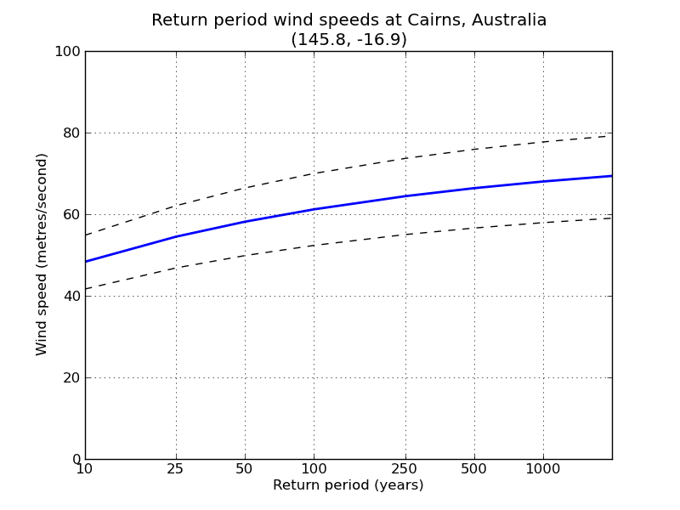
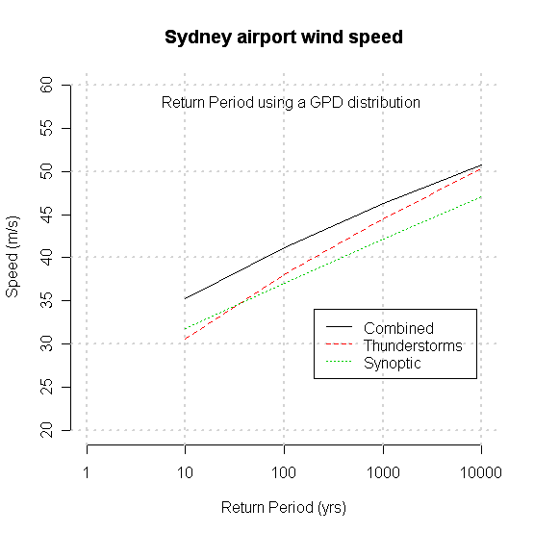
Hazard Analysis and Mapping
Example return period hazard curve derived from GA’s statistical-parametric TC model TCRM.
Example statistical analysis of observed wind records to determine return period wind speeds.

Slide 21
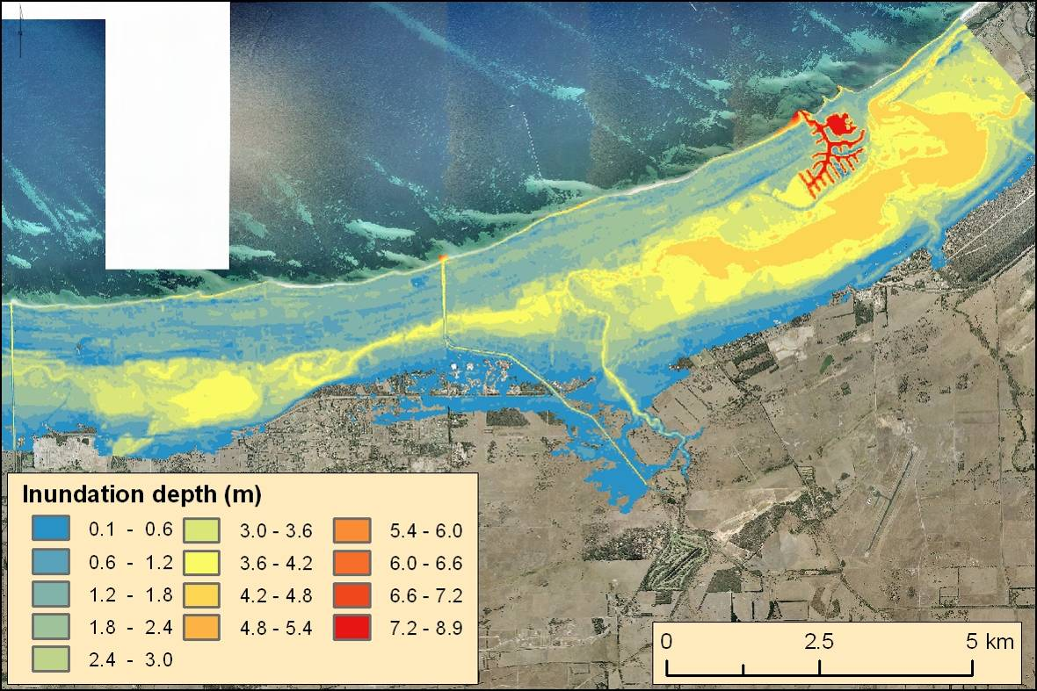
Hazard Analysis and Mapping
Example concident flood (100 year ARI event), storm surge inundation (TC Alby 1978) and sea level rise (1.1m at 2100) hazard map.
Notes:
21

Slide 22
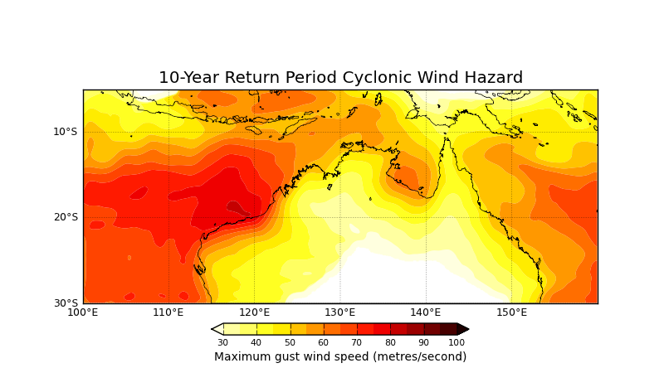
Hazard Analysis and Mapping

Slide 23
Final point …………
Hazard Observation Data Archival and Management and Hazard analysis and mapping – primarily scientific and research agencies – operational responsibilities
Agreed and consistent standards and methodologies variously applied
Supports hazard RISK assessment and hazard risk management – wider stakeholder partnerships across emergency management and DRR

Slide 24
THANK YOU
QUESTIONS ?

